Slide 1

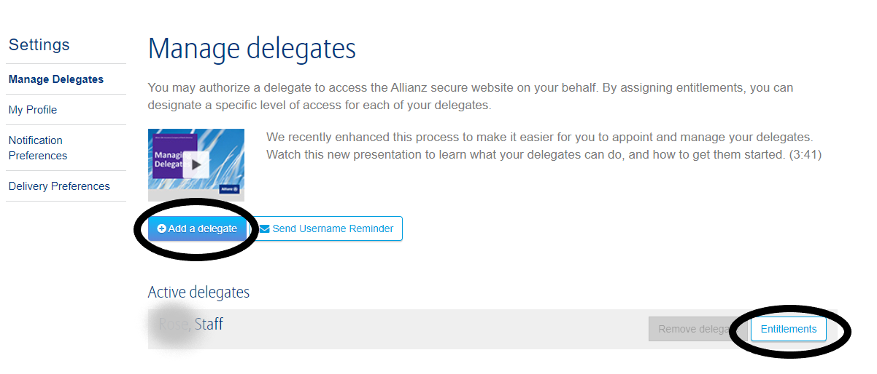
How to Set Up & Manage Delegates
Step 1:
Step 2:
Notes:
*Brainshark video link provided on slide #62
*Also provide, 1 sheet walkthrough guide
Step 1: To set up and manage delegates – log in, go to upper blue bar, find your name and click to display drop down, click on Manage Delegates
Step 2: On the managing delegates page, you may add a delegate by selecting the blue button titled Add a delegate. Or on this page, you may manage or change entitlements to an already active delegate – to do so, found the active delegate you want to make changes to and click on entitlements.

Slide 2
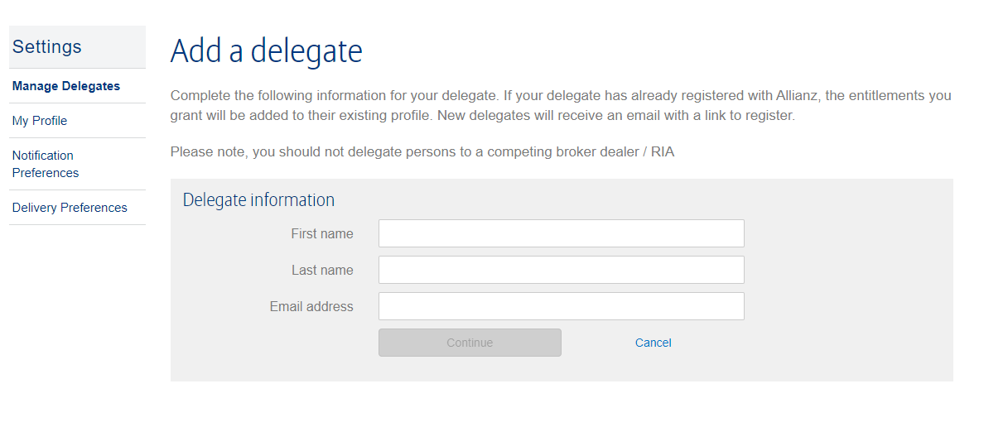
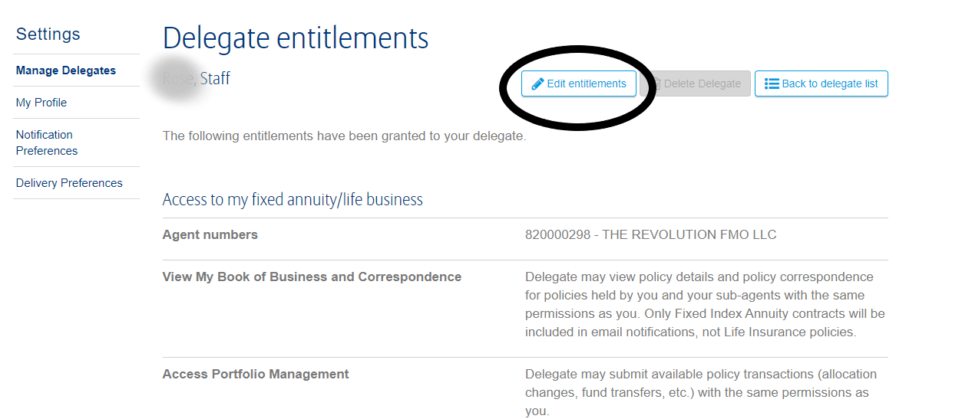
How to Set Up & Manage Delegates - continued
Adding a Delegate:
Edit Delegate Entitlements:
Notes:
Adding a delegate – enter the first name, last name, and email address on new delegate and select continue. Once you select continue, a new page will appear where you will elect what entitlements you want your delegate to have.
To edit delegate entitlements – click on edit entitlements, a list of entitlements will appear with check boxes – check all boxes that you want your delegate to have access to on the Allianz Life website.
Entitlements include:
View book of business/correspondence
Access portfolio management
View production information
View agent eligibility
Access illustration systems
Access ApplyNow
Access Secure Website
Access Knowledge Center
Etc…

